Slide 1

Vel Tech Rangarajan Dr. Sagunthala R&D Institute of Science and Technology
School of Computing
Department of Computer Science and Engineering
10211CS224 / FULL STACK APPLICATION DEVELOPMENT (JAVA)
MODEL LAB
Date: 17-04-2026
TICKET BOOKING OF AN INTERNAL DEPARTMENT EVENT
SDG: SDG 4-Quality Education
Presented By:
PAVANI SWETHA – VTU26633 – 23UECS0843.
Courses Handling Faculty:
Dr.Hafizur Rahman – Assistant Professor

Slide 2
INTRODUCTION
1
In academic institutions, organizing internal department events requires efficient coordination, especially in managing participant entry through ticketing. Traditional methods such as manual registration or paper-based ticketing often lead to confusion, errors, and lack of proper record maintenance. To overcome these challenges, a digital ticket booking system is essential.
The proposed system provides an online platform where students and staff can easily view event details and book tickets in advance. It ensures real-time tracking of ticket availability and prevents overbooking. The system maintains a centralized database, allowing organizers to manage events and participants efficiently.
This project enhances transparency, reduces manual workload, and improves user experience by providing a simple and user-friendly interface. It is highly relevant in today’s digital environment, where automation plays a key role in improving efficiency and accuracy.
2
3
4
5
6
7
8
9

Slide 3
PROBLEM STATEMENT
1
In many departments, the process of booking tickets for internal events is still handled manually through paper-based entries or simple spreadsheets. This approach often results in issues such as duplicate bookings, incorrect data entry, and difficulty in tracking the number of participants. There is no proper system to monitor ticket availability in real time, which may lead to overbooking or last-minute confusion during events. Additionally, managing and verifying participant details becomes time-consuming for organizers.
Due to the absence of a centralized and automated system, the overall efficiency of event management is reduced. Therefore, there is a need for a reliable, user-friendly, and automated ticket booking system that can streamline the process, ensure accurate data handling, and improve the overall management of internal department events.
2
3
4
5
6
7
8
9

Slide 4
OBJECTIVE(S)
1
• To design and develop Ticket booking of an Internal Department Event
• To implement efficient booking,tracking and management of event tickets.
• To ensure user friendly experience for booking tickets.
2
3
4
5
6
7
8
9

Slide 5
PROPOSED SYSTEM
1
• Online ticket booking system for students and staff
• User registration and login functionality
• Real-time ticket availability tracking
• Admin panel to manage events and bookings
• Secure data storage using database
• Automatic booking confirmation
• Easy cancellation and updates
• Reduces manual errors and saves time
2
3
4
5
6
7
8
9

Slide 6
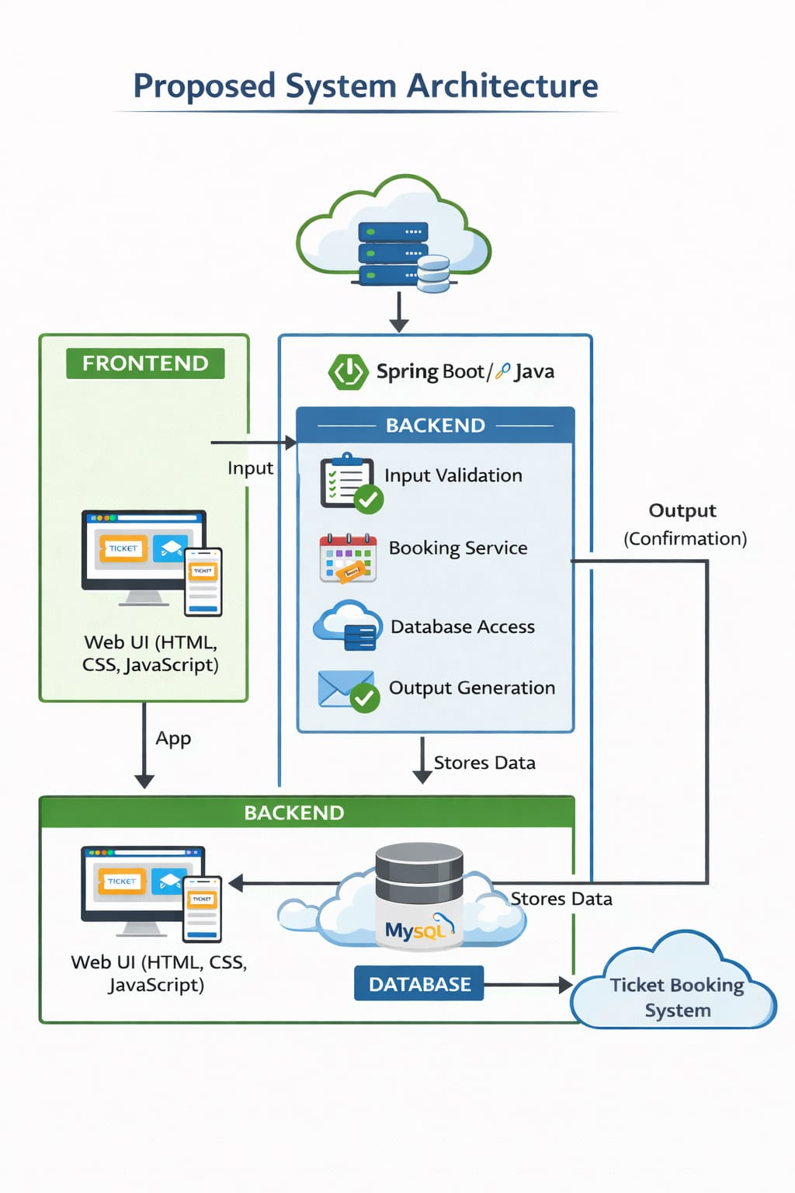
PROPOSED SYSTEM ARCHITECTURE
Input
User details ,event selection.
Processing
Booking validation,seat availability check expenses
Database
Stores user data,booking data,etc.
Output
Displays booking confirmation,ticket details.
1
2
3
4
5
6
7
8
9

Slide 7
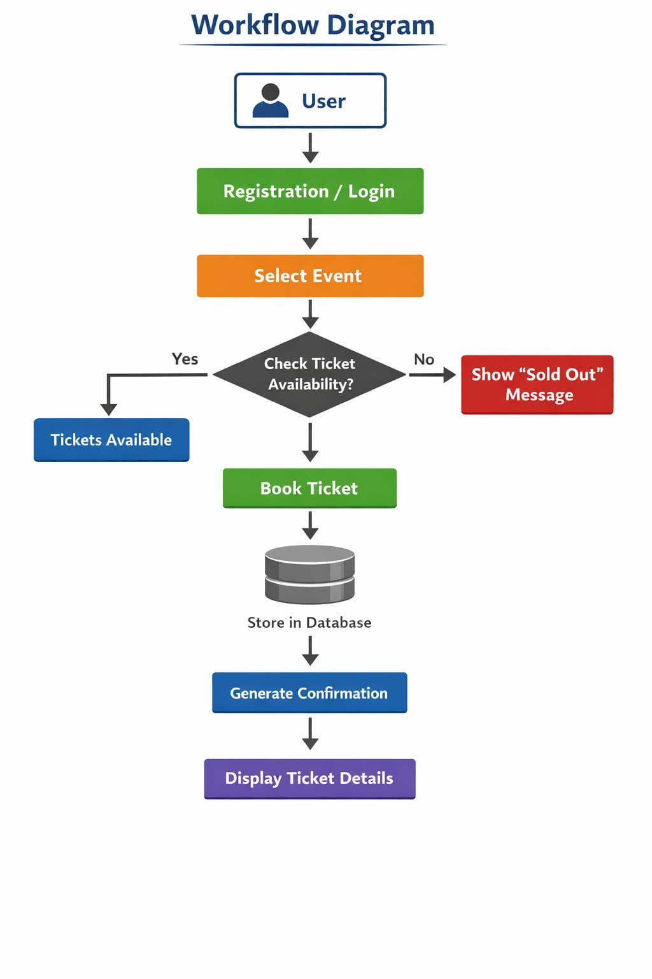
WORKFLOW
1
2
3
4
5
6
7
8
9

Slide 8
TECHNOLOGIES USED
1
Frontend: React JS,JSX,CSS3
Software Tools:VS Code ,MySQL Workbench.
Hardware Requirements:Windows/Linux/macOS
- Hardware Requirements: Standard PC with Internet
Web Browser
2
3
4
5
6
7
8
9

Slide 9
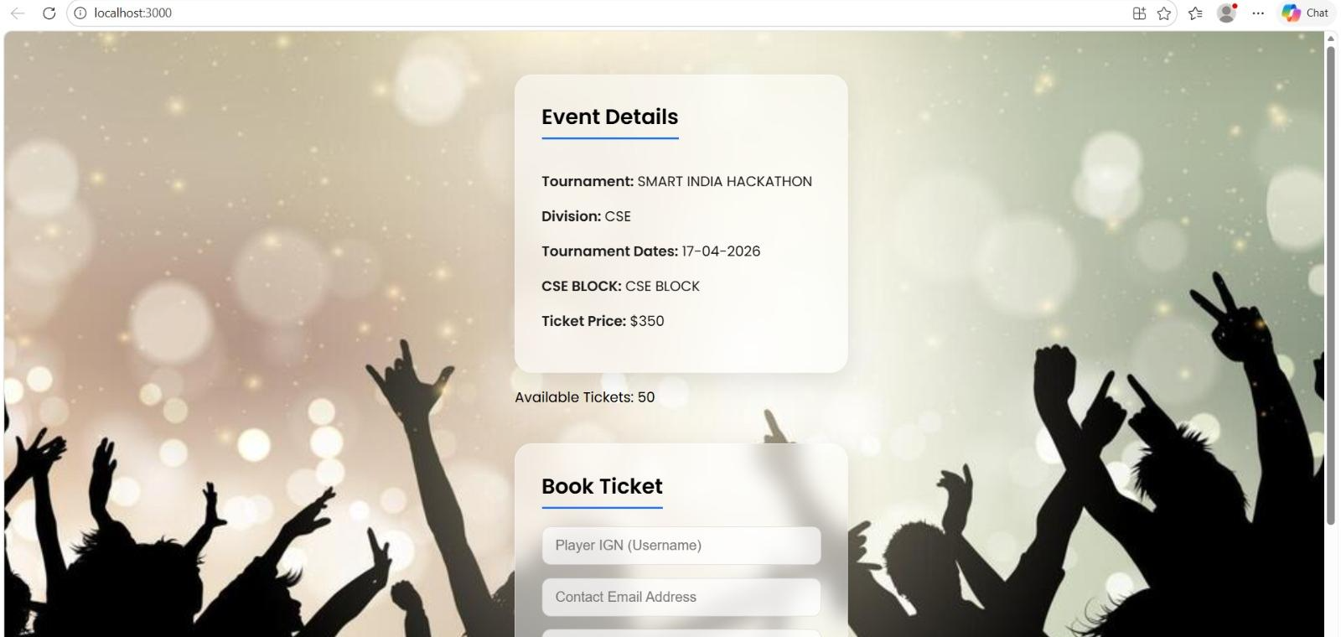
IMPLEMENTATION SCREENSHOTS
1
2
3
4
5
6
7
8
9

Slide 10
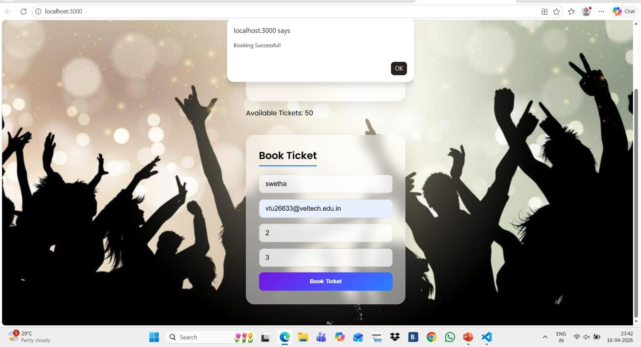
IMPLEMENTATION SCREENSHOTS
1
2
3
4
5
6
7
8(A)
9
.

Slide 11
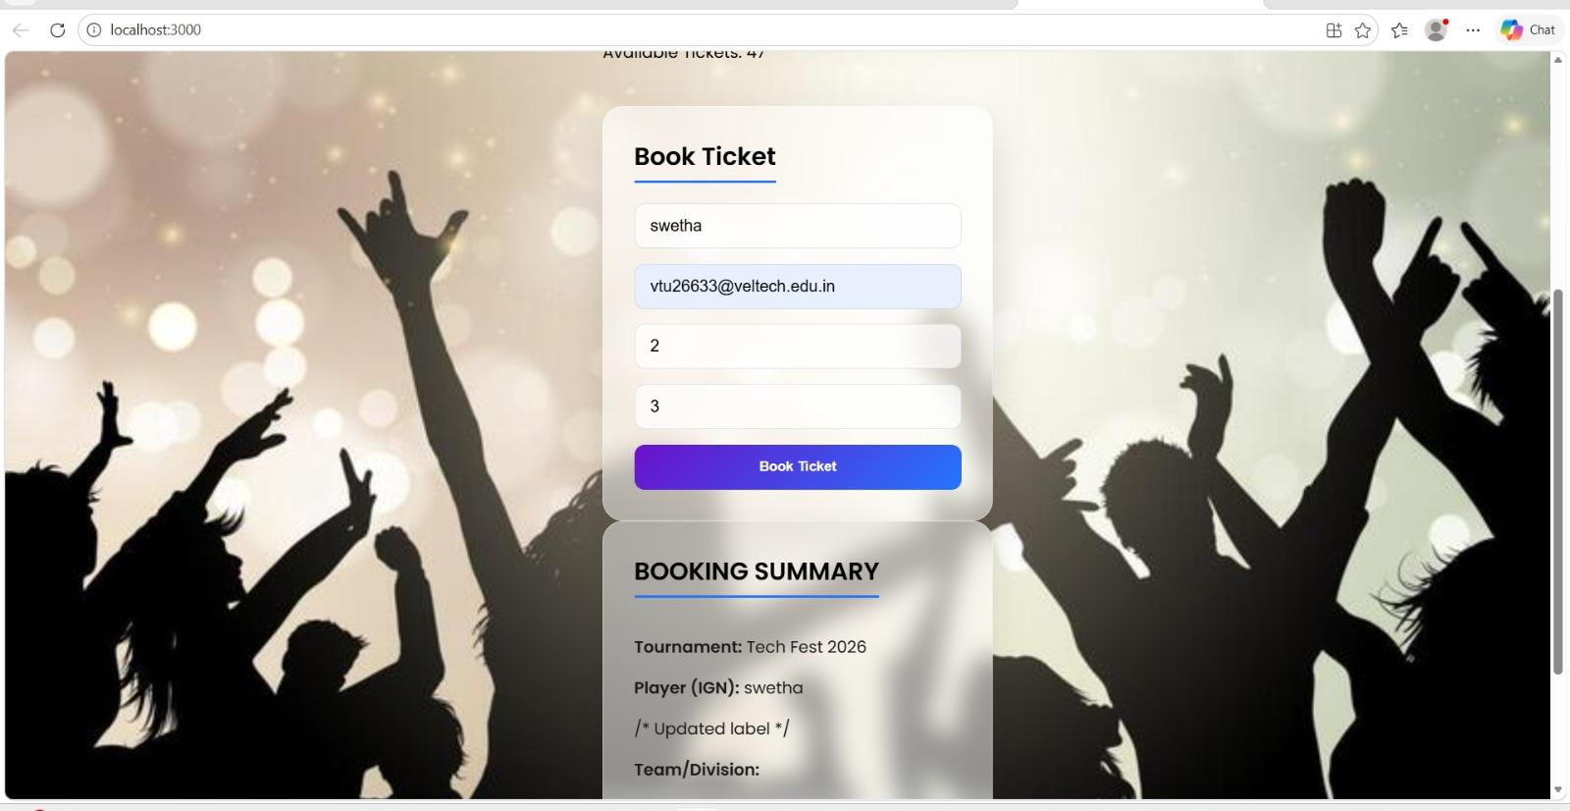
IMPLEMENTATION SCREENSHOTS
1
2
3
4
5
6
7
8(B)
9
.
I

Slide 12
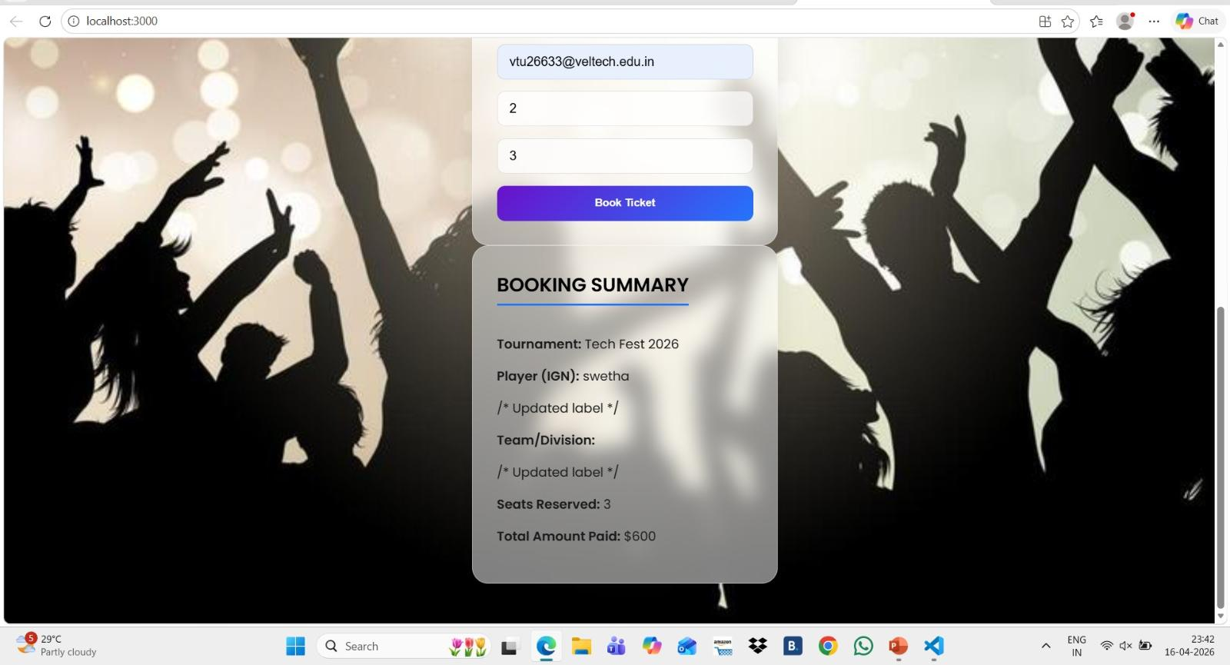
IMPLEMENTATION SCREENSHOTS
1
2
3
4
5
6
7
8(C)
9

Slide 13
ADVANTAGES & LIMITATIONS
1
ADVANTAGES:
• Easy to use and user-friendly.
• Accurate data management.
• Provides visual insights.
• Saves time compared to manual methods.
LIMITATIONS:
• Requires internet connection
• Limited to basic analytics in current version
• Basic Security.
2
3
4
5
6
7
8
9

Slide 14
Thank you

